Slide 1
High Cloud Airlines
Group - 1

Slide 2
Agenda
Introduction
Business Problem
Data Model
Visualization
Conclusion & Suggestions

Slide 3
Introduction
The HighCloud Airlines data set is a collection of data about the operations of airlines in the US and abroad. It contains information such as flight delays, cancellations, destinations, distances, and load factors. The data set can be used for various data analysis and visualization purposes, such as finding the best and worst performing airlines, identifying the causes of delays, and exploring the trends and patterns of air travel.

Slide 4
Business Problem
How can airlines provide best service to their customers
How to reduce load factor on flights

Slide 5
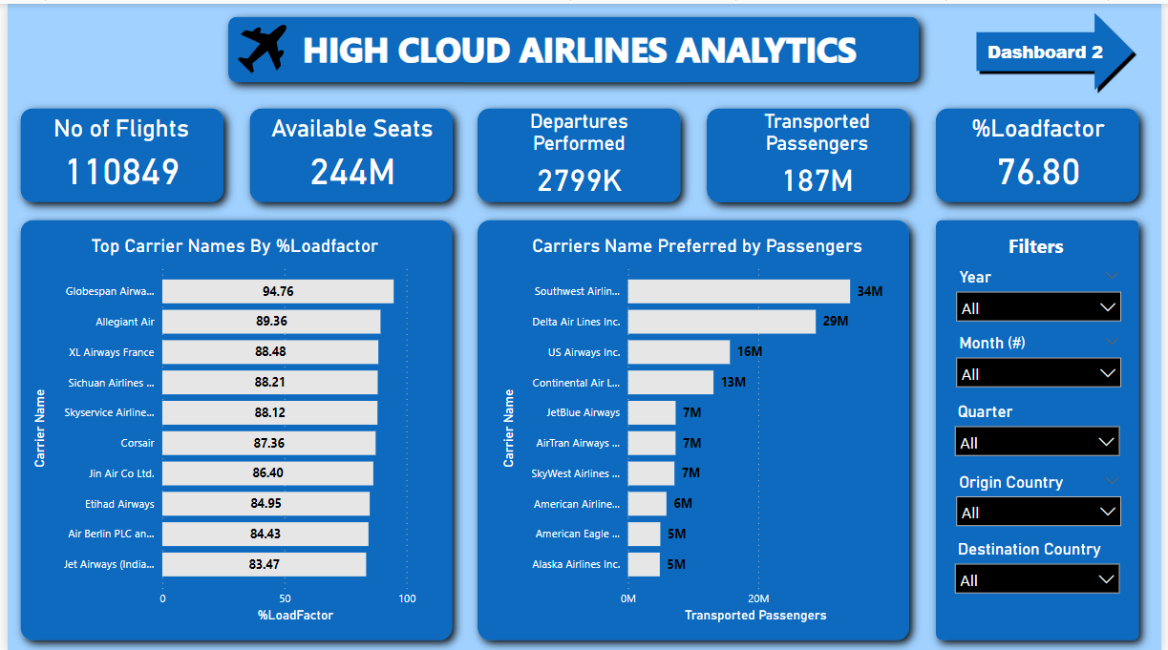
Business opportunities are like buses. There's always another one coming.
“
”
Richard Branson

Slide 6
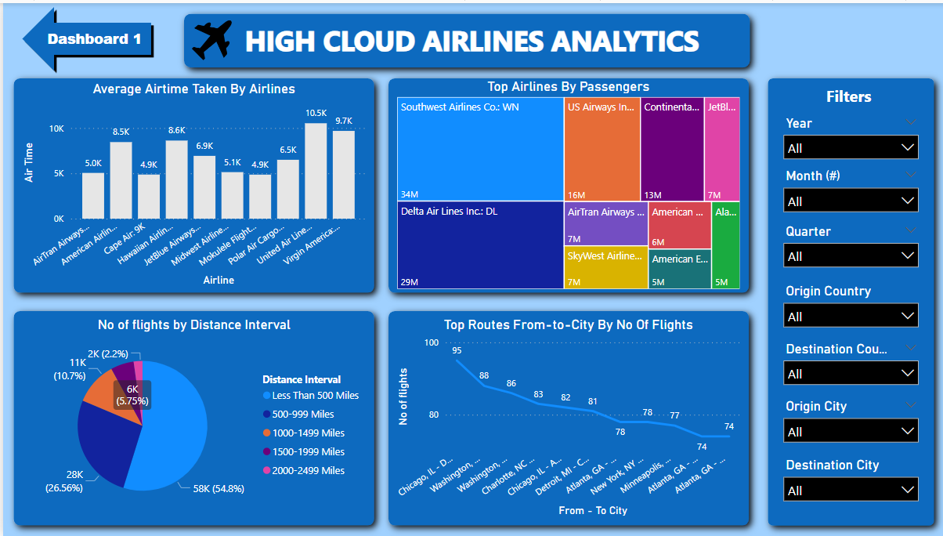

Slide 7
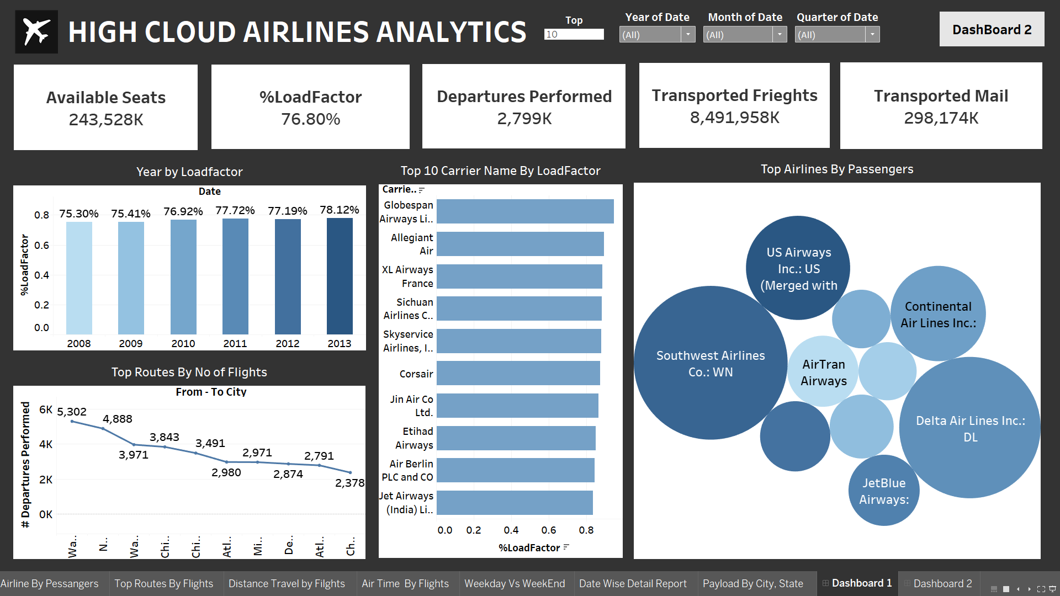

Slide 8
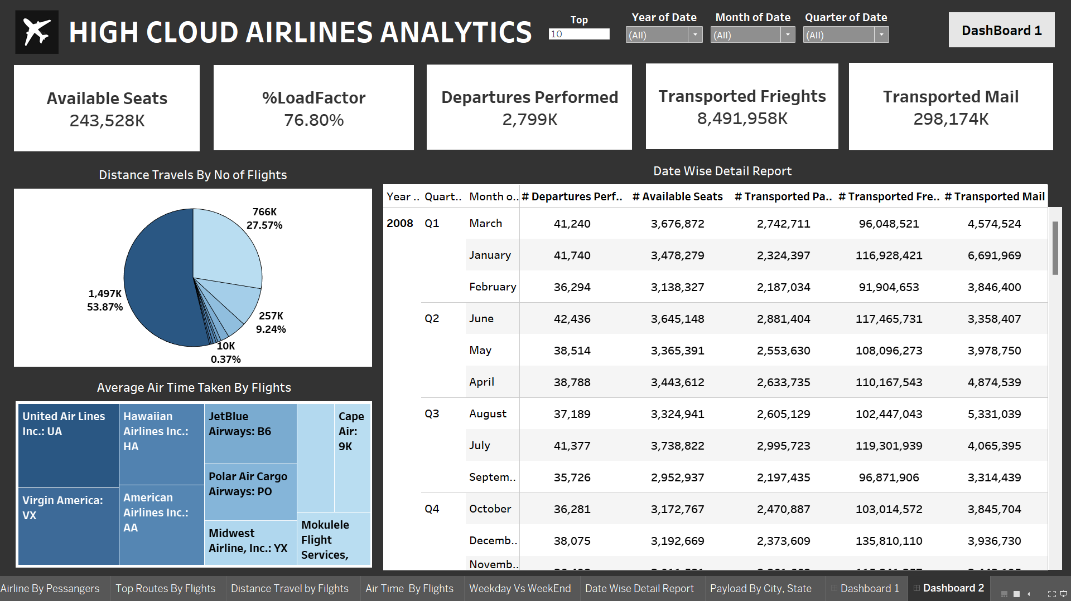

Slide 9
Conclusion
Operational Insights:
Cross-Functional Collaboration:
The dashboard provides real-time insights into flight operations, crew management, and passenger experiences. It enables data-driven decision-making across departments.
The dashboard encourages collaboration between flight operations, crew scheduling, and customer service teams. It facilitates proactive responses to operational challenges.

Slide 10
Suggestions
Predictive Analytics:
Enhanced Customer Insights
Route Optimization:
Incorporate predictive models to anticipate flight delays, crew availability, and resource bottlenecks. Use historical data to forecast demand and optimize flight schedules.
Explore route optimization algorithms to minimize fuel costs and enhance passenger convenience. Consider seasonal variations and demand fluctuations.
Dive deeper into passenger feedback and sentiment analysis. Understand pain points (e.g., lost baggage, in-flight services) and address them promptly.

Slide 11
Thank you

